Slide 1
Interaction Studio- Journey Builder SYNC

Slide 2

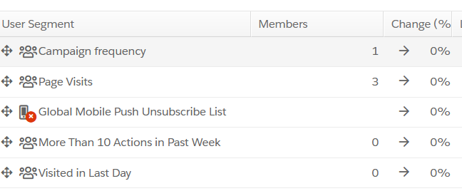
Journey Builder Integration: Send a User to Journey Builder Upon Segment Join
How IS will be useful for Journey Builder in SFMC:
Interaction Studio listens through web, mobile, API, and data feeds, constantly gathering data about visitors ,then updates existing segments in real-time
Use these segments to add customers to Journey Builder Journeys within moments of the data changing.
Examples
Visitors who view your product more than three times in a week
Visitors who sign up for a service.
Visitors who visit specific pages on the website.
Notes:
Zack
Definition
Sitemap is made up of many page type configs
1 page type config => 1+ pages
Category page (1+)
Homepage (1)
Login page (1)
Purpose
Organize sitemap code structure and logic
Define where an event originated

Slide 3
PreRequisites
The are 3 things that needs to be configured for starting
Identity Attributes (in IS)
Data Extension(in SFMC)
API Entry Source(in Journey Builder -SFMC)
Notes:
Katherine

Slide 4
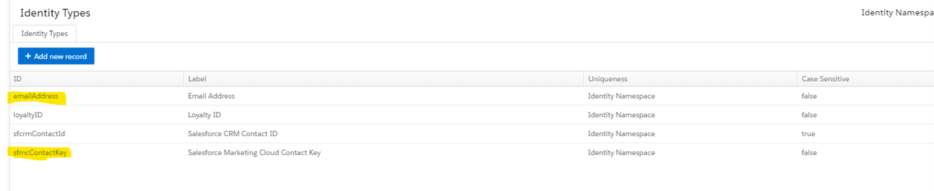
Identity Attributes
Attributes in IS used to determine a unique know individual
We need to create the Identity Attributes mentioned below:
sfmcContactkey
emailAddress
Notes:
Den

Slide 5
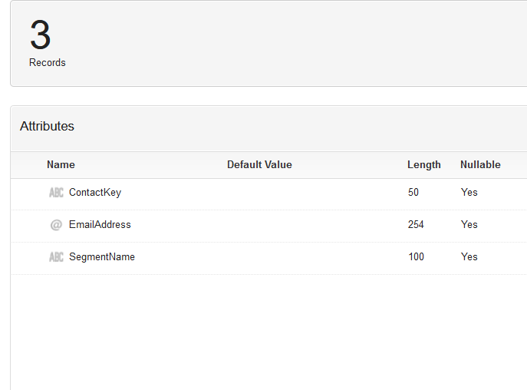
Data Extension
Create a Data Extension with the fields mentioned below:
ContactKey(Text)
EmailAddress(Email)
SegmentName(Text)
Make sure the Fields names are exact same as mentioned
here otherwise the data won’t sync into DE when coming
through Interaction Studio

Slide 6
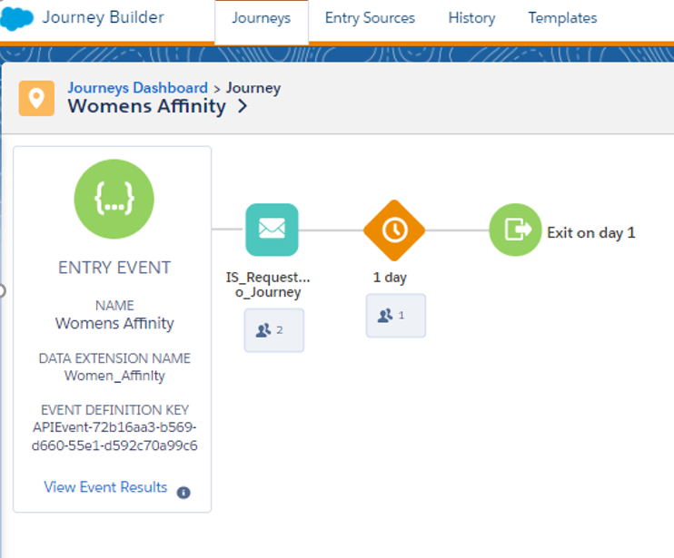
API Entry Source
Create an API entry Source.
Use that as Entry Source of Journey
Build your journey flow with other activities that
is required
You can use this Journey as a without any activities that collects data in real time.
Later you can use Automation to join this data with a different DE and use that as DE entry source in a different Journey.
Notes:
Den

Slide 7
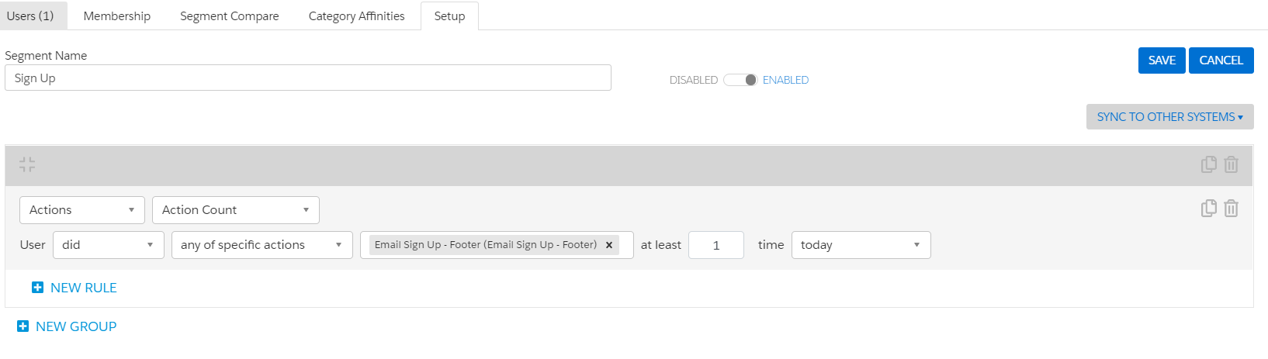
Integrating Segment with Journey Builder
Create a segment in Interaction Studio which will start to store users based on the action criteria that you configure in the segment and Save
Click on SYNC TO OTHER SYSTEMS.
Notes:
Den

Slide 8
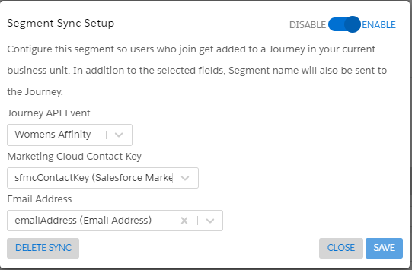
Integrating Segment with Journey Builder
Select the API Event which was configured in the Journey
Select the SFMC Contact Key in Marketing Cloud Contact Key Section.
Select the Email Address in Email Address Section
Once this is done, Enable the Sync and Save it.

Slide 9
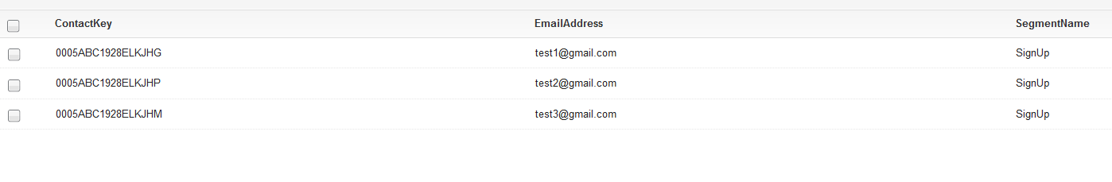
Synchronized Data
Once you go back and check DE, the data will start to flow into DE on real time.
DE should have ContactKey, Email Address and Segment Name populated.
Notes:
Den

Slide 10
Important Points :
The DE field names should be same as mentioned. Otherwise, the fields won’t get mapped with the fields in Interaction Studio.
The records that are present already in segments before the sync wont flow into SFMC. The records which enter segment only after Sync will flow into SFMC.
The Journey which contains API event should be active so that records could flow into SFMC. (It would show up in IS segment eventhough Journey not in active state).
The contacts don’t need to be part of All Subscribers list to show up in SFMC DE when it is synced.
Notes:
Den

Slide 11
Reference Links
https://doc.evergage.com/display/EKB/Send+a+User+to+Journey+Builder+Upon+Segment+Join
https://doc.evergage.com/display/EKB/Configure+Identity+Types+and+Attributes
Notes:
Katherine

